Slide 1
LOREN: Logic-Regularized Reasoning for Interpretable Fact Verification
Jiangjie Chen, Qiaoben Bao, Changzhi Sun, Xinbo Zhang,
Jiaze Chen, Hao Zhou, Yanghua Xiao, Lei Li
Shanghai Key Laboratory of Data Science, School of Computer Science, Fudan University
ByteDance AI Lab University of California, Santa Barbara
Fudan-Aishu Cognitive Intelligence Joint Research Center
AAAI 2022
Code: https://github.com/jiangjiechen/LOREN.
Zhuomin Chen
2022.03.06

Slide 2
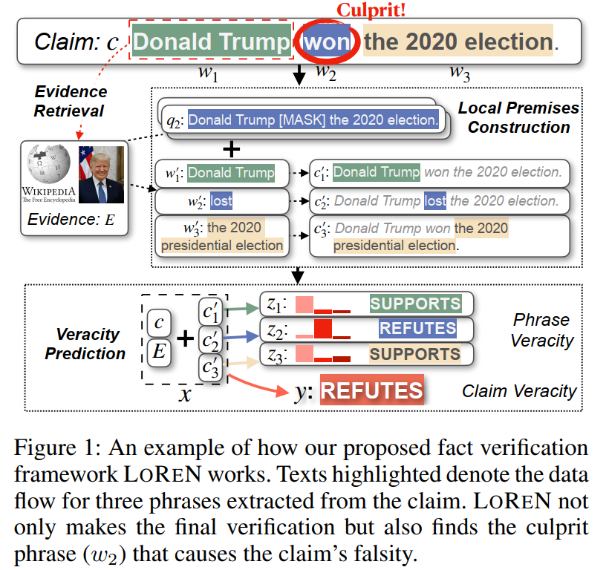
Introduction
罪魁祸首
Current methods are limited in interpretability,
as they usually only give an overall verdict.
It is challenging to learn interpretable models that not only predict but also explain its rationale, since there is a lack of truthfulness labels on the phrase level.

Slide 3
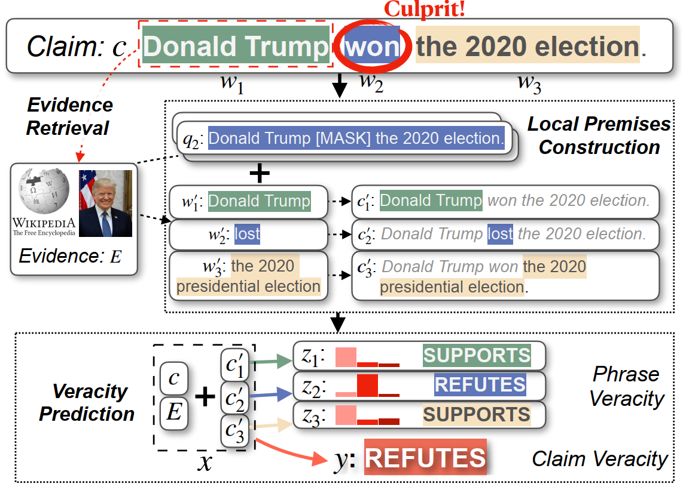
Methodology
Claim Verification
Goal: model the probability distribution
supported (SUP), refuted (REF), not-enough-information (NEI)
Phrase Verification

Slide 4
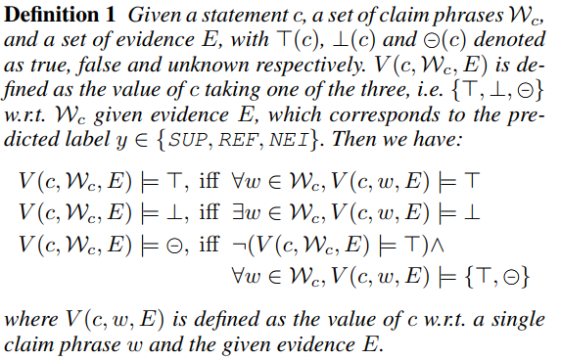
Logical Constraints
supported (SUP), refuted (REF), not-enough-information (NEI)

Slide 5
Overview of LOREN
Latent Model:
the objective function :
amortize the variational posterior distribution with neural networks

Slide 6
Overview of LOREN
Logical Knowledge Distillation:
The teacher model is constructed by projecting variational
Distribution into a subspace, denoted as

Slide 7
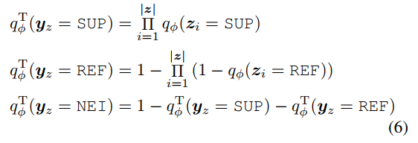
Teacher Model Construction
Given probability of the claim phrase veracity , we logically aggregate them into as follows

Slide 8
Building Local Premises
generative machine reading comprehension (MRC)
Probing Question Generation
Local Premise Construction

Slide 9
Building Local Premises
generative machine reading comprehension (MRC)
Self-supervised Training of MRC
The MRC model takes as input a probing question and
evidence sentences and outputs answer(s) for the question.

Slide 10
Veracity Prediction
encode the claim and concatenated evidence sentences as
into global vector

Slide 11
Veracity Prediction

Slide 12
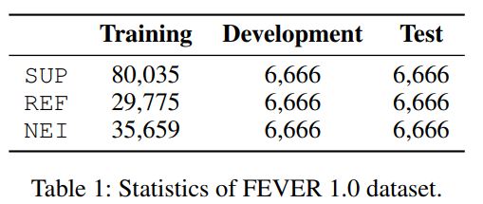
Experiments

Slide 13
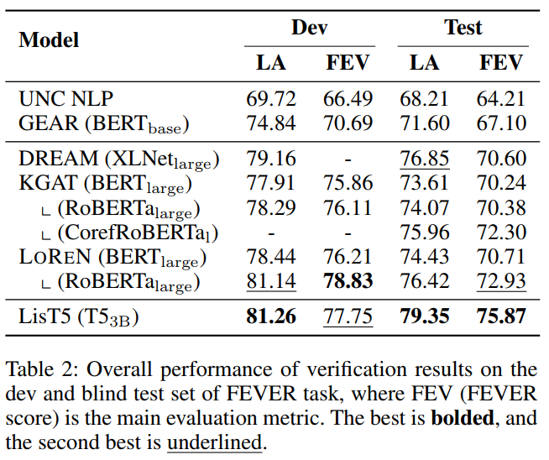

Slide 14
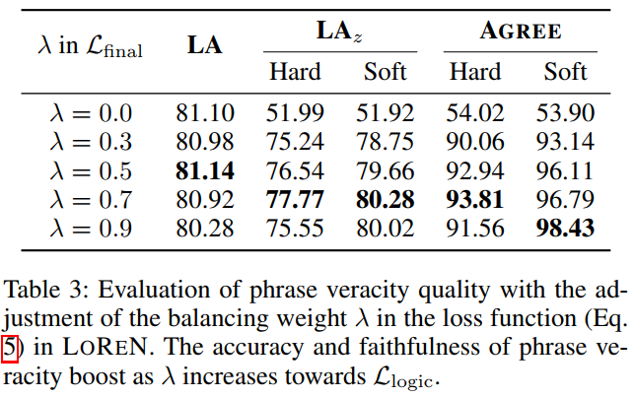

Slide 15
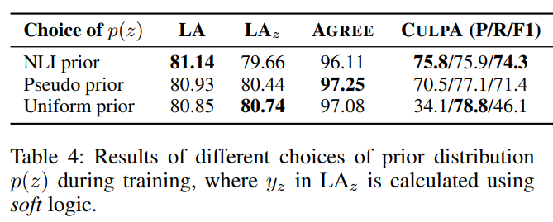

Slide 16
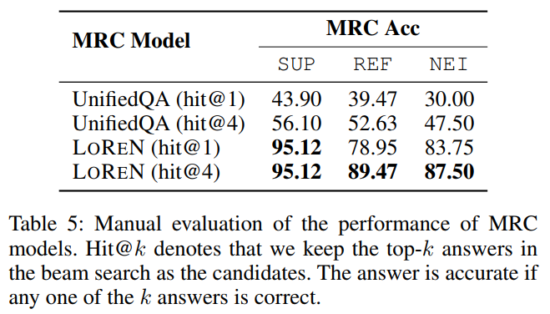

Slide 17
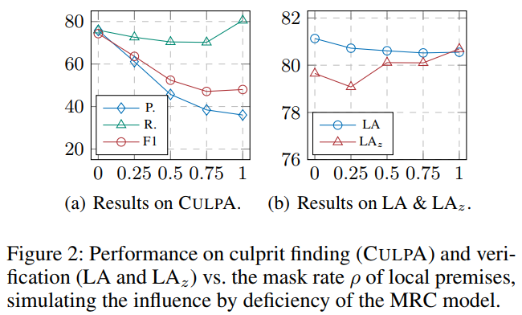

Slide 18
